Slide 1
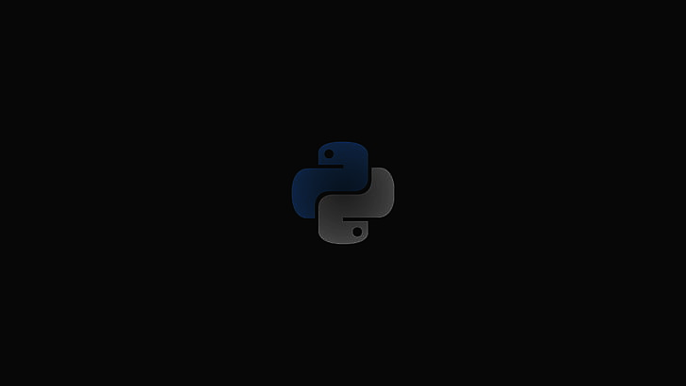
Functions in Python
A function is a organized, reusable block of code that is used to perform a specific action.
Functions are mostly a part of a larger piece of code that solves the problem.
Functions run only when we call them explicitly.
You can pass data, known as parameters, into a function.
A function can return data as a result.
Types of Functions
Built-in functions: predefined functions like print() etc.
2. User-defined functions: you can create your own functions.

Slide 2
Defining a Function
Syntax:
def function_name(parameters):
"""
Docstring: Description of the function (optional but recommended)
"""
# Function body: Perform operations here
# Use parameters as required
# Indentation is crucial in Python to define the scope of the function
# Return statement (optional)
return some_value
Example:
def calculate_rectangle_area(length, width):
"""
This function calculates the area of a rectangle.
Parameters:
length: float or int
width: float or int
Returns:
The area of the rectangle (length * width).
"""
area = length * width
return area

Slide 3
Types of user defined functions
1. Function without Arguments:
Functions that do not take any arguments and execute a predefined set of operations when called.
Example:
def greet():
print("Hello!")
2. Function with Arguments:
Functions that accept one or more parameters as input to perform specific operations.
Example:
def add_numbers(a, b):
return a + b
3. Function with Default Arguments:
Functions where parameters have default values that are used if no argument is provided during the function call.
Example:
def greet(name = "User"):
print(f"Hello, {name}!")
4. variable-length Arguments:
Functions capable of accepting a varying number of arguments.
*Arbitrary Arguments (args):
Example:
def add(*args):
return sum(args)

Slide 4
4. variable-length Arguments:
**Keyword Arguments (kwargs):
Example:
def person_info(**kwargs):
for key, value in kwargs.items():
print(f"{key}: {value}")
5. Recursive Functions:
Functions that call themselves either directly or indirectly to solve a problem by breaking it down into smaller instances.
Example:
def factorial(n):
if n == 0 or n == 1:
return 1
else:
return n * factorial(n-1)
6. Anonymous (Lambda) Functions:
Small, nameless functions defined using the lambda keyword that typically perform simple operations.
Example:
square = lambda x: x * x
Each type of user-defined function in Python serves a unique purpose and provides programmers with the flexibility to handle various scenarios and perform specific tasks efficiently.

Slide 5
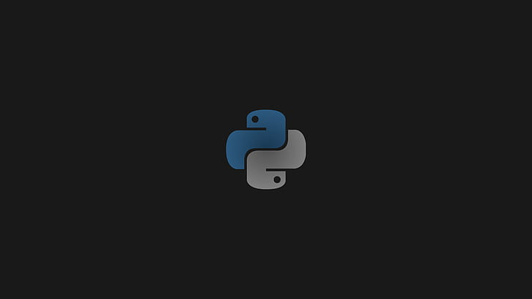
Modules in Python
Module is a python file(.py) containing a set of functions you want to include in your application.
A module’s contents are accessed with the import statement.
The basic syntax to create a module:
1. Create a Python File:
Open a new file and save it with a .py extension. For example, mymodule.py.
2. Add Code to the Module File:
Include functions, classes, or variables in the Python file that you want to make available as part of the module.
Example of a simple module named mymodule.py:
# File: mymodule.py
def greet(name):
print(f"Hello, {name}!“)
def add_numbers(a, b):
return a + b
my_variable = 10

Slide 6
Using the Module:
Once the module is created, you can use its contents in other Python scripts by importing it using the import statement.
Example of using the mymodule module in another Python script:
# File: main.py
import mymodule
mymodule.greet("Alice") # Calling function from the module
result = mymodule.add_numbers(5, 3) # Using a function from the module
print(result)
print(mymodule.my_variable) # Accessing a variable from the module
Built-in Modules:
Modules that are a part of the Python Standard Library, available for use without requiring additional installations.
Examples include math, datetime, os, random, etc.

Slide 7
Data Manipulation
Data manipulation in Python refers to the process of altering, transforming, or organizing data to extract useful information.
It involves various operations such as filtering, sorting, aggregating, cleaning, and modifying datasets using Python libraries like Pandas, NumPy, or built-in functions.
Example of data manipulation in Python using the Pandas library
CSV file named data.csv containing information about students:
Name | Age | Grade
Alice | 15 | A
Bob | 16 | B
Charlie | 14 | C
David | 15 | A
Emma | 14 | B

Slide 8
Now, using Pandas in Python, you can read this data into a DataFrame and perform basic data manipulation operations:
import pandas as pd
# Reading the CSV file into a Pandas DataFrame
df = pd.read_csv('data.csv')
# Displaying the original DataFrame
print("Original DataFrame:")
print(df)
print()
# Filtering data based on conditions (e.g., students older than 14)
filtered_data = df[df['Age'] > 14]
# Displaying the filtered DataFrame
print("Filtered DataFrame (students older than 14):")
print(filtered_data)
print()
# Calculating the average age of students
average_age = df['Age'].mean()
print(f"Average Age of Students: {average_age:.2f}")

Slide 9
Thank you

